Slide 1

CLEAR-ROAD: Near Real-time Aggregation and Extraction of Co-occurring Intrusion Alerts
Gordon Werner
Ph.D. Student
Rochester Institute of Technology
This talk includes efforts supported by NSF Awards # 1526383 and #1742789, and RIT Global Cybersecurity Institute.

Slide 2
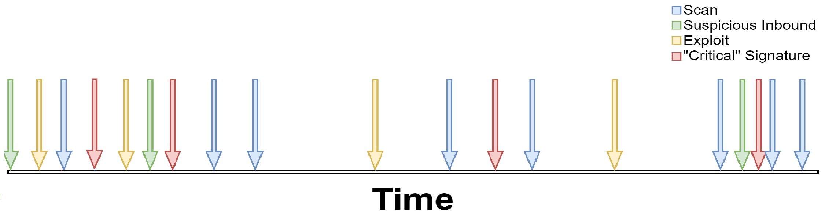
Helping Analysts Understand Attack Patterns
Problem: How to better and more quickly help analysts to understand critical signature occurrence patterns? What signatures co-occur with them? And in what timing profile?
  Can this be done in near real time (NRT)? Without any external training data?
Existing works (alert aggregation or alert correlation) depend on a priori defined templates / trained models or focus on grouping “similar” alerts.
Is there an effective, data
driven way to process
Individual alert streams?
Are these groups of alerts the same? What are
the odds that these alerts would occur together?
Notes:
The previous examples and many others have led to three use-cases CACR concluded in this collaboration.

Slide 3
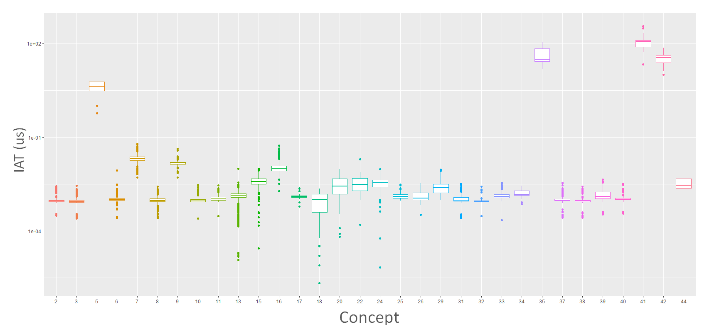
CLEAR (Concept Learning for Intrusion Event Aggregation in Realtime)
Tracks “concepts” (w.r.t. IATs) and derives “aggregates” (set of temporarily related alerts).
Statistically match ongoing aggregates to concepts using 2-sample
Kolmogorov-Smirnov (K-S) test.
CLEAR
Multiple temporal patterns found that contain
“GPL EXPLOIT CodeRed v2 root.exe access”
TSSD-EWMA
Notes:
The previous examples and many others have led to three use-cases CACR concluded in this collaboration.

Slide 4
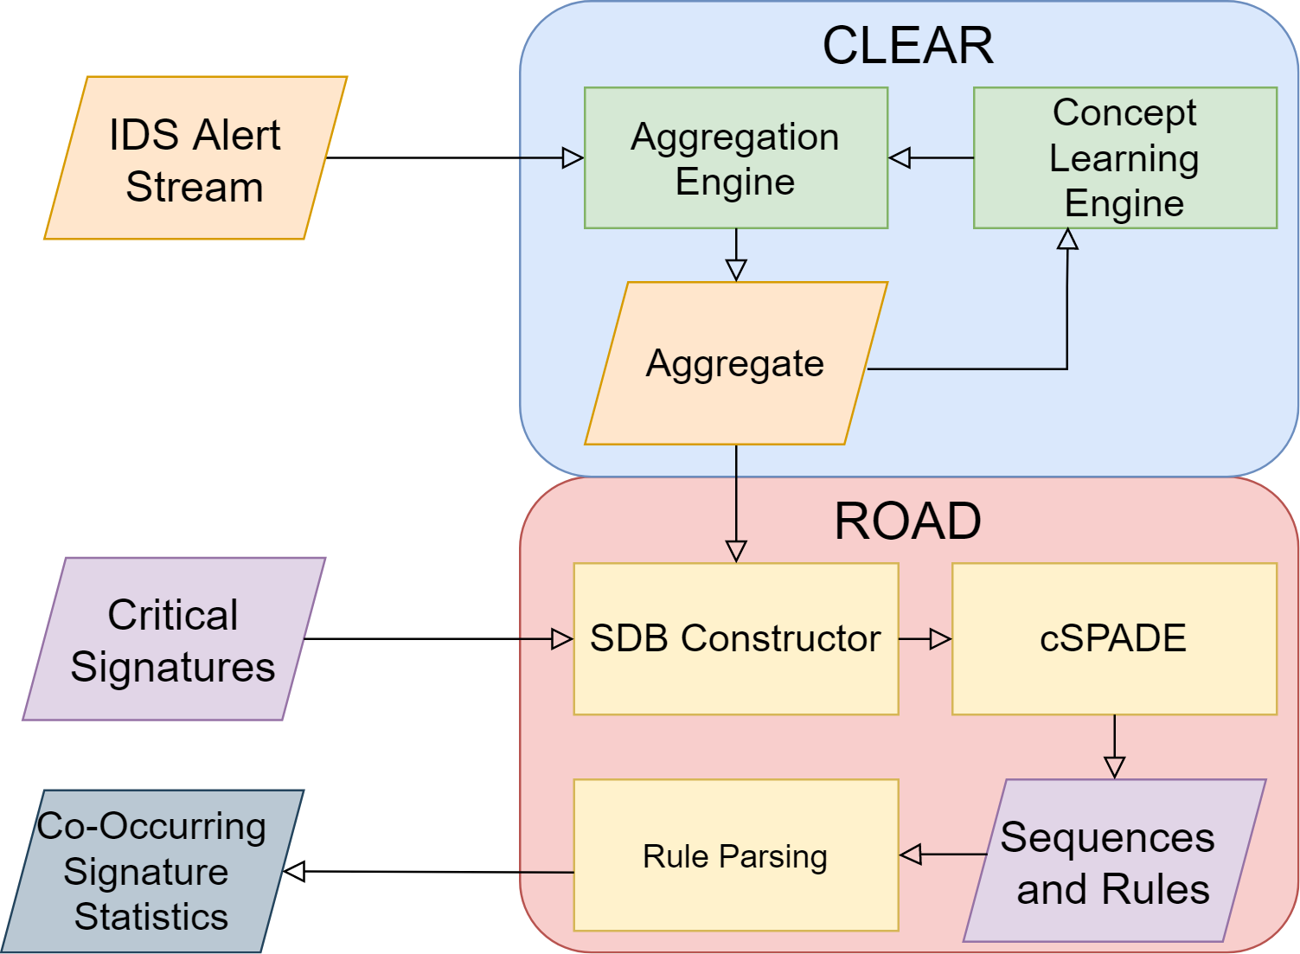
CLEAR with Rare Co-Occurring Alert Signature Discovery (CLEAR-ROAD)
Two-Step Approach:
  CLEAR Learns & maintains unique, invariant temporal arrival patterns as “Concepts”
    In NRT from incoming alerts
    Captures individual ``actions” or “Aggregates” using concept statistics
  ROAD Extracts “Co-Occurring Signatures” from Aggregates
    Leverages pattern mining techniques
    Sequence alert signatures using aggregates
    Constrains sequence data base (SDB) to reduce computational overhead
    Finds rules that exhibit statistical likelihood for signature co-occurrence
Notes:
The previous examples and many others have led to three use-cases CACR concluded in this collaboration.

Slide 5
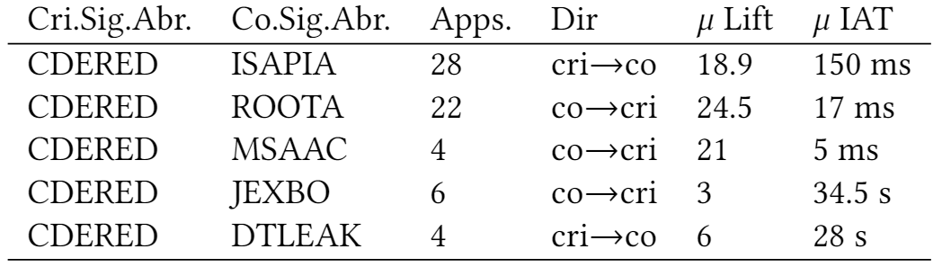
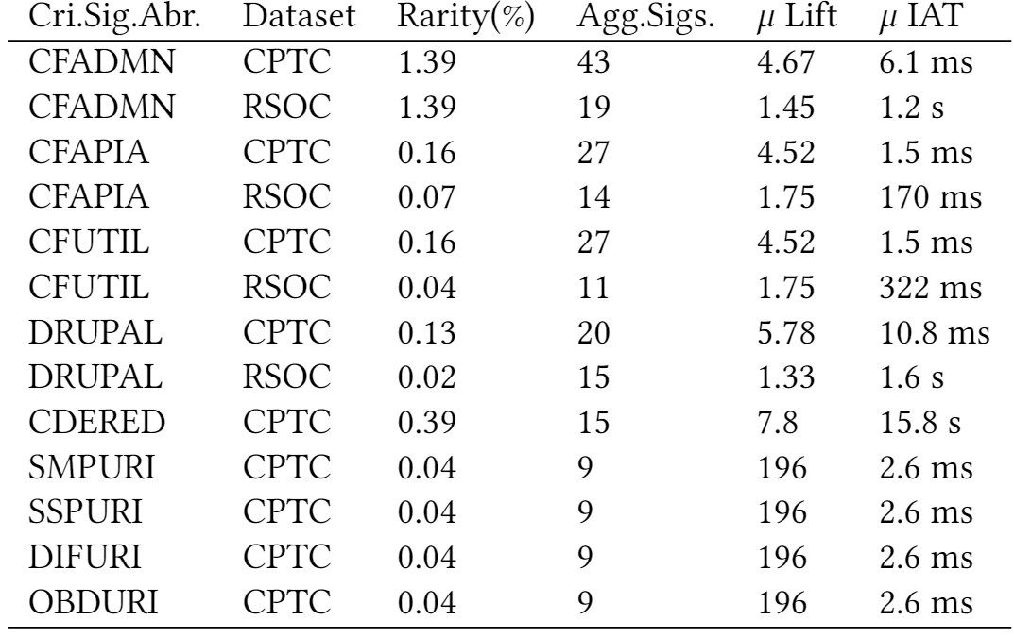
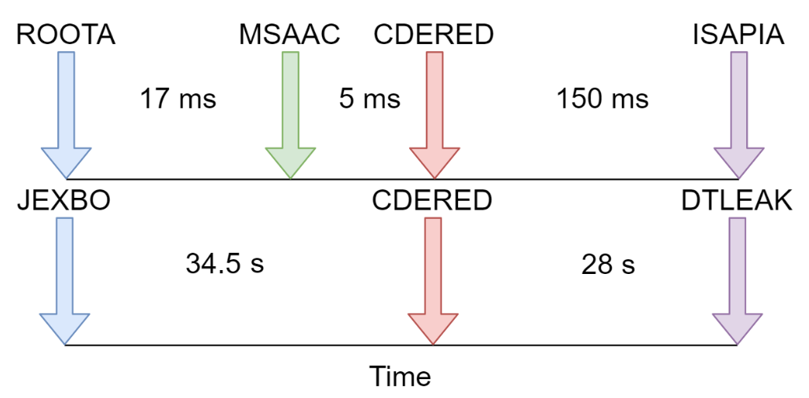
ROAD – (Rare co-Occurring Alert signature Discovery)
SPADE – a pattern mining algorithm [Zaki’2001] modified to work with CLEAR and Intrusion Alerts.
Discovers and processes association rules containing critical signatures
Isolates signatures whose occurrence is statistically likely related to critical signature’s
(To-do) incremental update patterns in NRT.
Co-Occurrence is unique to the 2 temporal “modes” found by CLEAR
Notes:
The previous examples and many others have led to three use-cases CACR concluded in this collaboration.

Slide 6

Comments, Ideas, & Questions
Notes:
The previous examples and many others have led to three use-cases CACR concluded in this collaboration.

