Slide 1
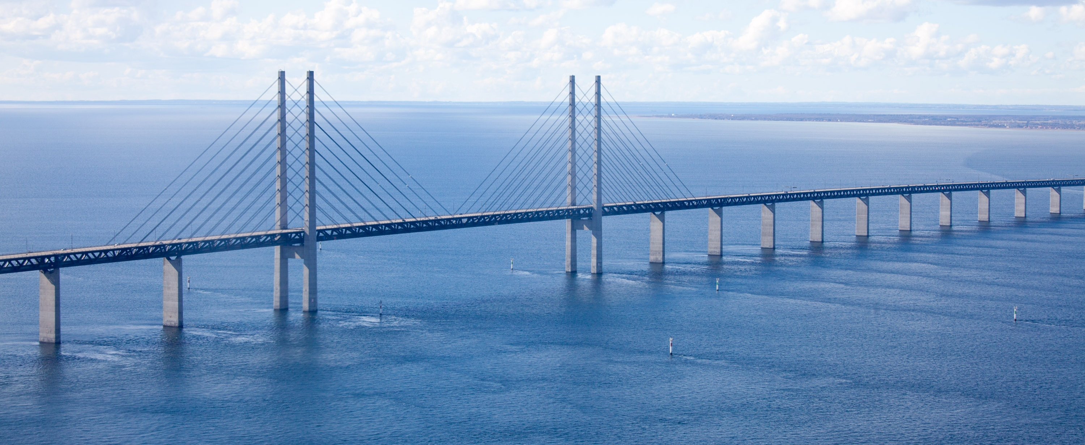
Using A Collated Cybersecurity dataset for Machine Learning and Artificial Intelligence
Erik Hemberg and Una-May O’Reilly

Slide 2
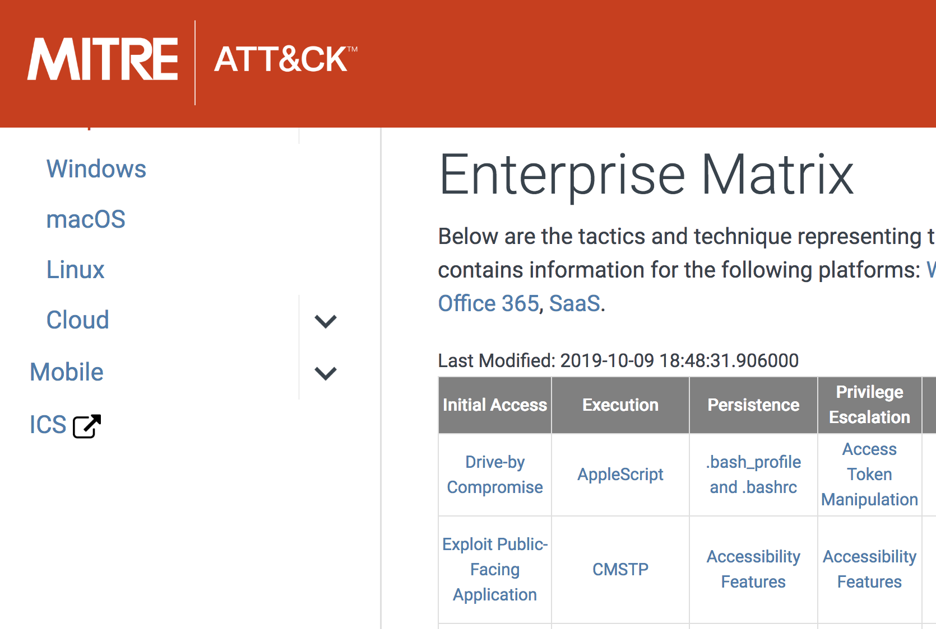

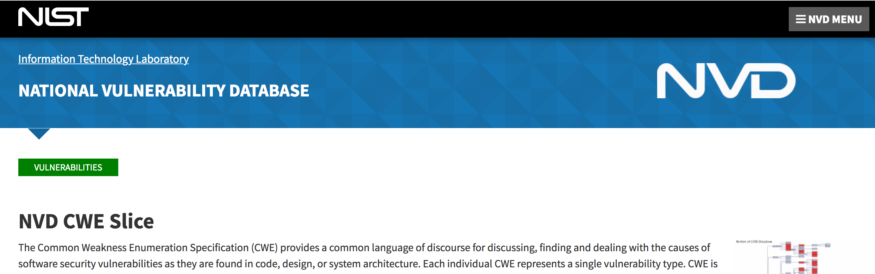
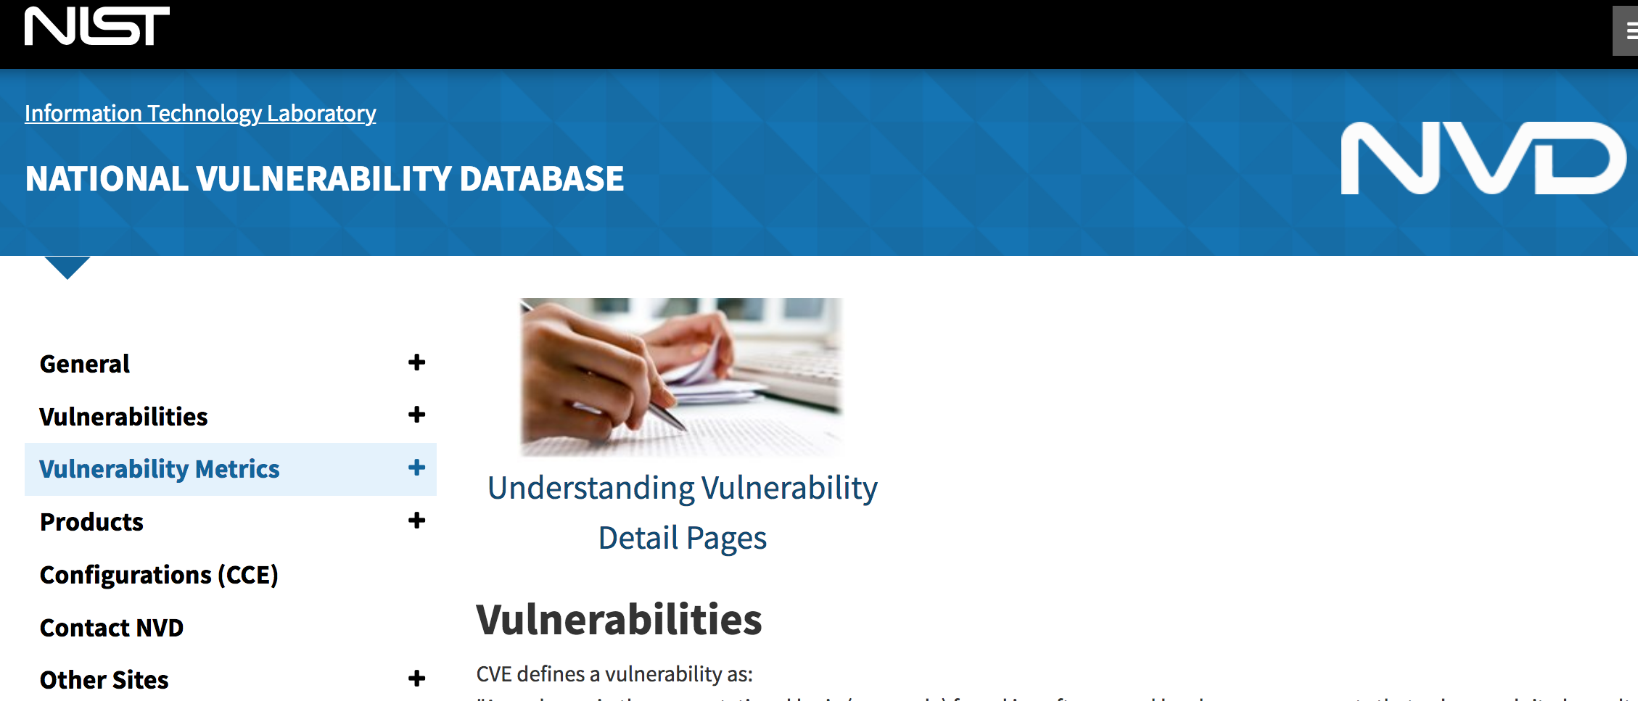
BRON: a Collated Cybersecurity Dataset
666
157
740
Notes:
Can BRON be used to facilitate the annotation of public cyber threat and vulnerability data?
666 Techniques and 740 CAPECs, a total of 492,840 possible Technique-CAPEC edges.
A total of 157 connected Technique-CAPEC edges, edge-ratio is 0.03187%.
The information used to populate BRON is incomplete, there is no way of knowing if this is because there are missing edges or no edges exist.
Given information on pairs of one Technique and one CAPEC we train a model that predicts if there is a known edge between the pair.
We encode information on Techniques and CAPECs using natural language processing into a float vector.
The model returns 1 for a known edge between the pair and 0 if there is no known edge (missing or non-existent).

Slide 3
Top 5 Prediction Models
  CWE and Tactic data with BOW features using Random Forest gives the best result
Notes:
Research goals
the difference in performance due to feature selection, i.e. when more data is provided from BRON,
the change in performance due to the feature representation,
a baseline classification performance established from untuned classifier models.
Data entry names from:
a) CAPEC b) Techniques c) Tactics d) CWE e) CAPEC-Technique
Feature representations
Bag of Words (BOW)
Transformer Neural Network (BERT (off-the-shelf))
Classifiers (SciKit-Learn default settings):
a) Multi Layer Perceptron (MLP), b) Random Forest, c) Logistic Regression (SGD), d) K-Nearest Neighbor (KNN). e) Naive Bayes (NB), f) Support Vector Machine, linear kernel (SVM) g) Support Vector Machine, radial basis function kernel (RBF-SVM)
Measures:
a) Error (1.0 - accuracy), b) AUC, c) F1-score
Experiments:
100 independent trials with different 70-30 train-test data splits. The data for each trial has 314 exemplars with 50-50 class balance (from under-sampling the majority class).

Slide 4
Queries of the 2020 Top 25 CWE in BRON

Slide 5
Summary and Future Work
We have demonstrated and discussed how BRON, a collated dataset supports ML and AI
  Uses of BRON include information retrieval, pattern inference, modeling & simulation and AI-based attack planning.
BRON could be enhanced with additional behavioral knowledge, from timely sources such as threat reports.
Acknowledgments.
  This material is based upon work supported by the DARPA Advanced Research Project Agency (DARPA) and Space and Naval Warfare Systems Center, Pacific (SSC Pacific) under Contract No. N66001-18-C-4036

